Slide 1
8/25/20 - plots
Order by variable:
F2000, F2000_Contrail, difference (F2000 – F2000_Contrail)

Slide 2
AREI

Slide 3
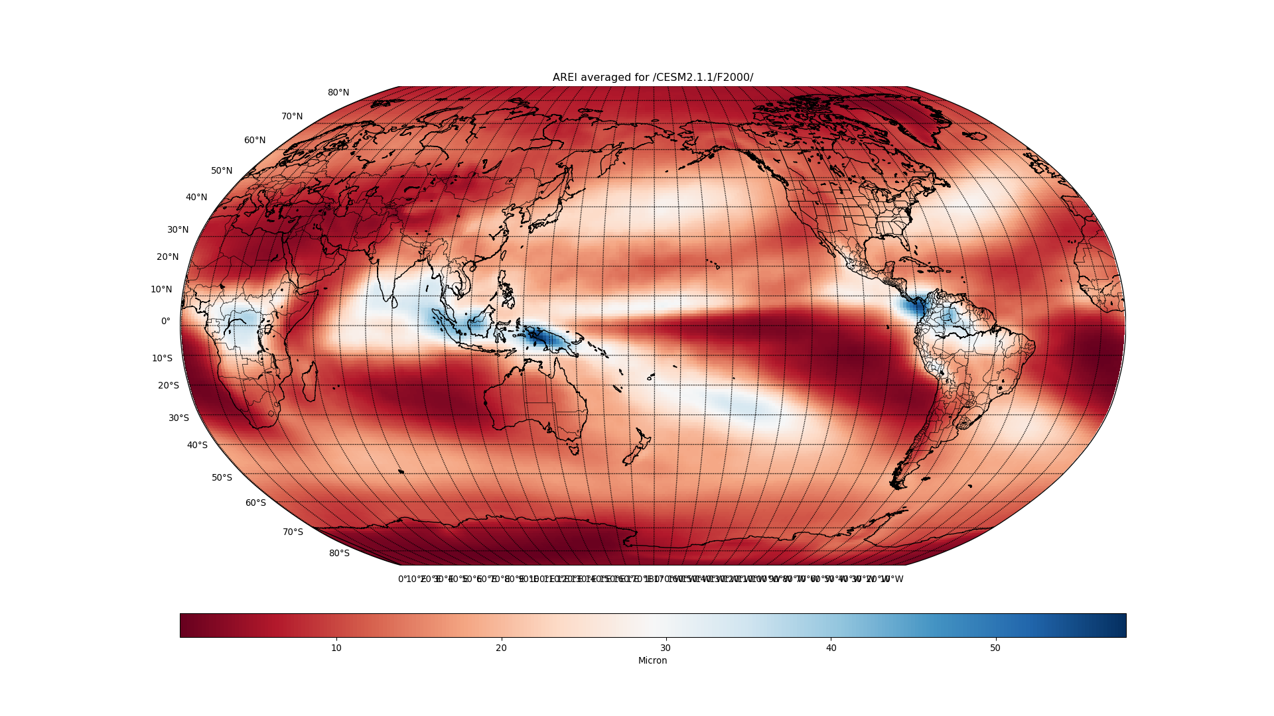

Slide 4
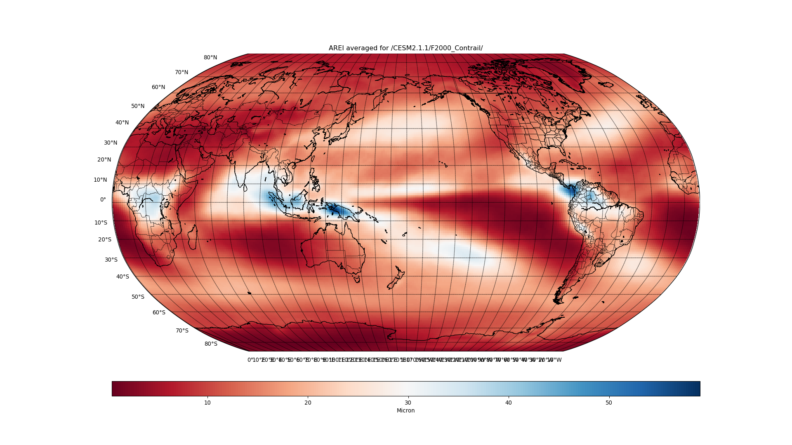

Slide 5
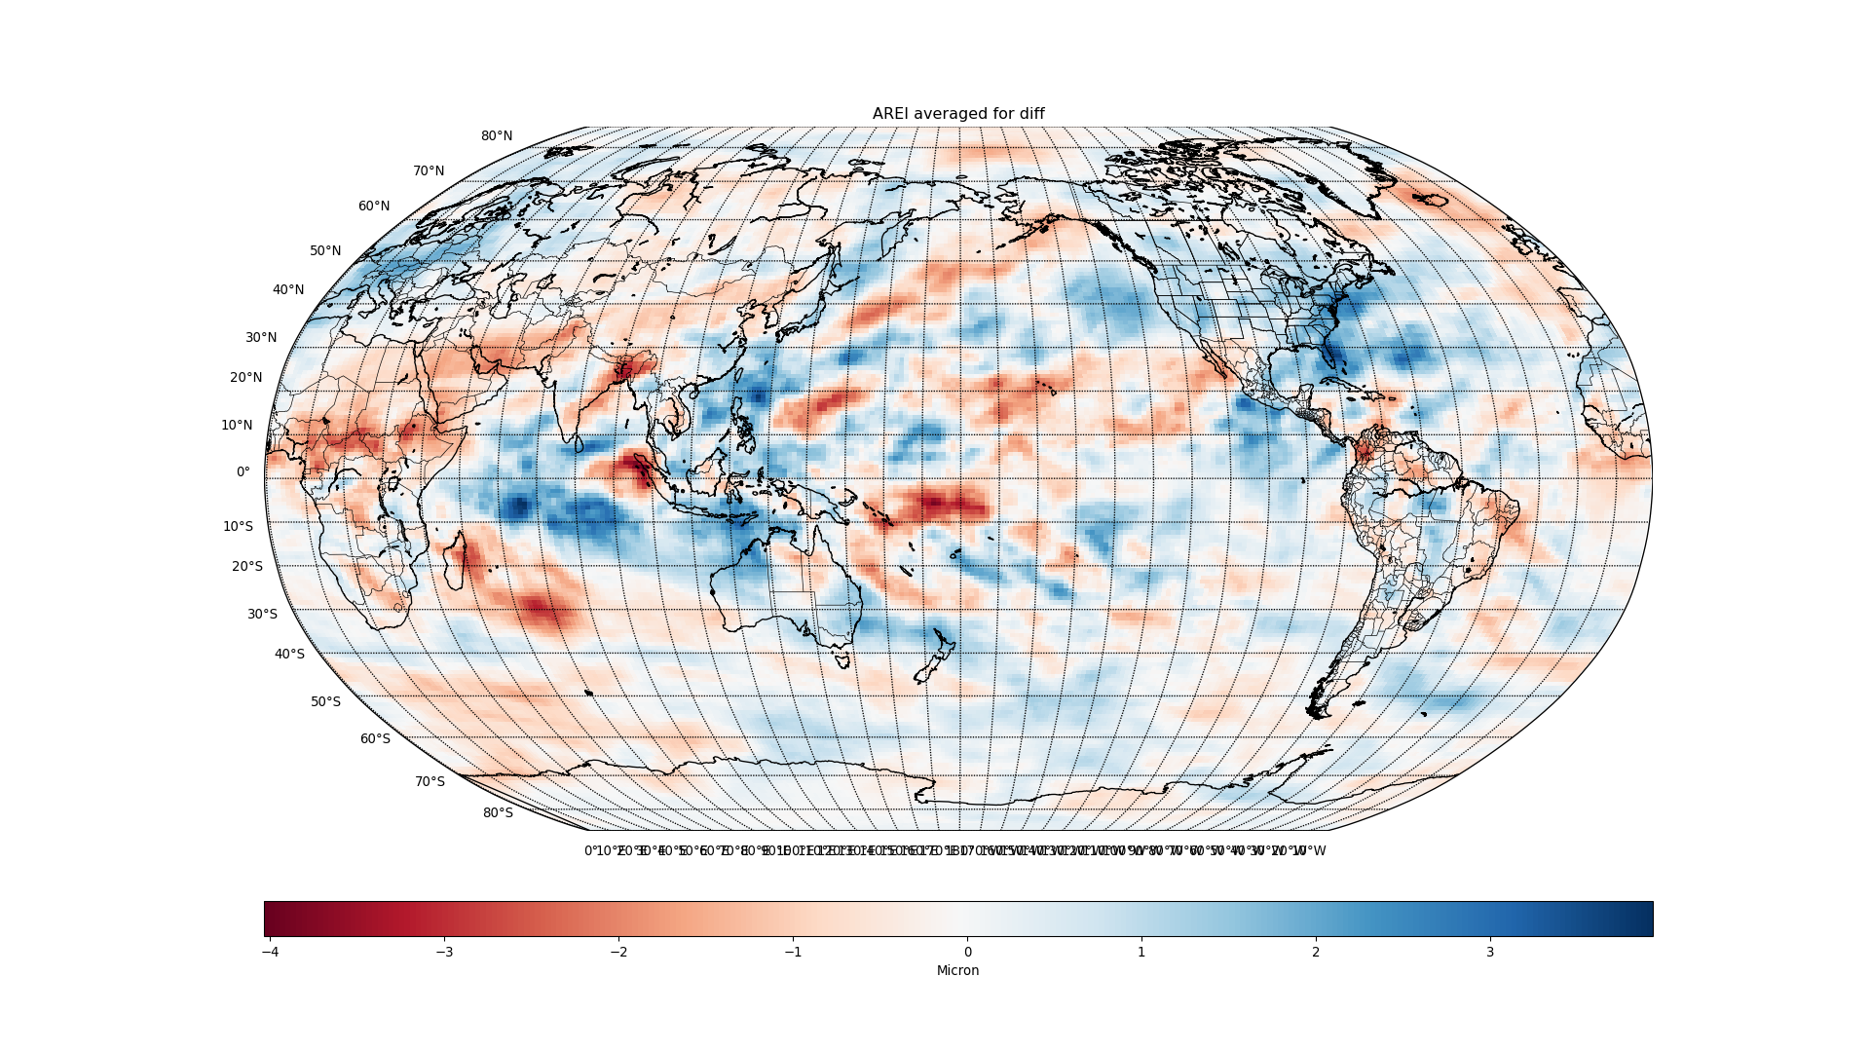

Slide 6
CLDICE

Slide 7
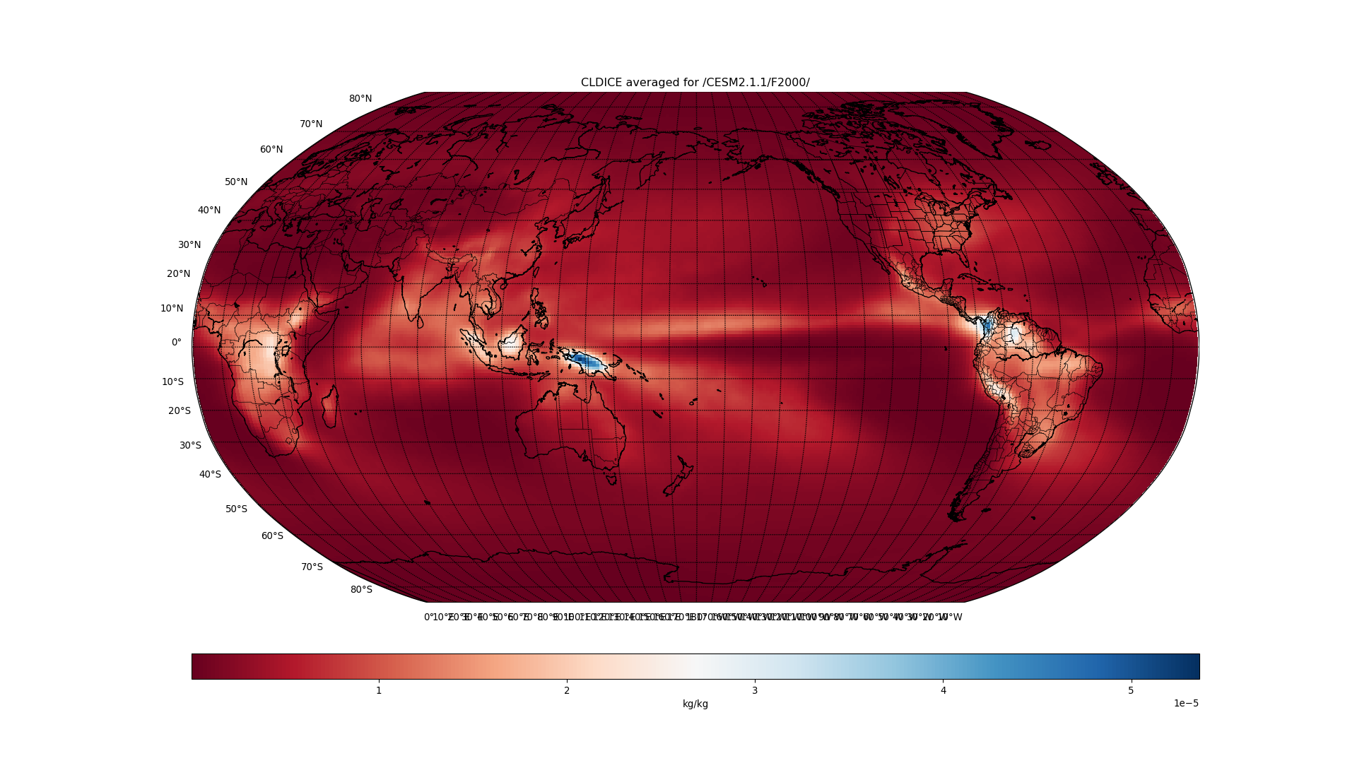

Slide 8
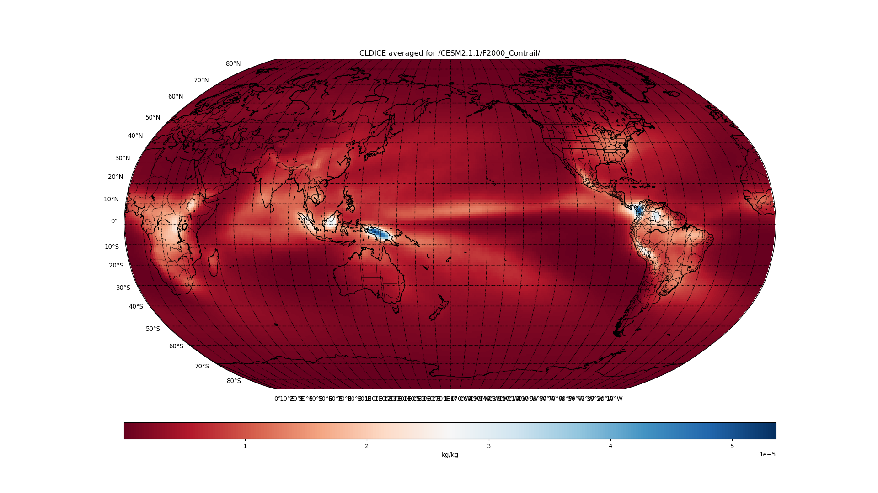

Slide 9
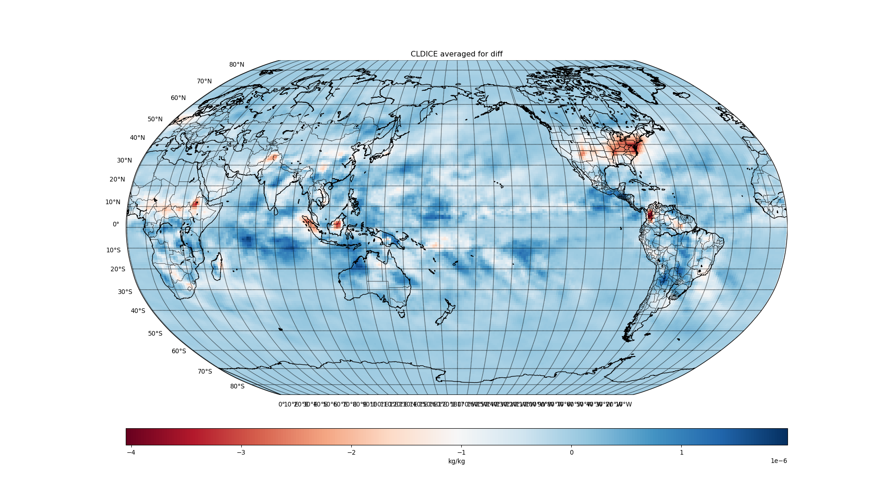

Slide 10
FREQI

Slide 11
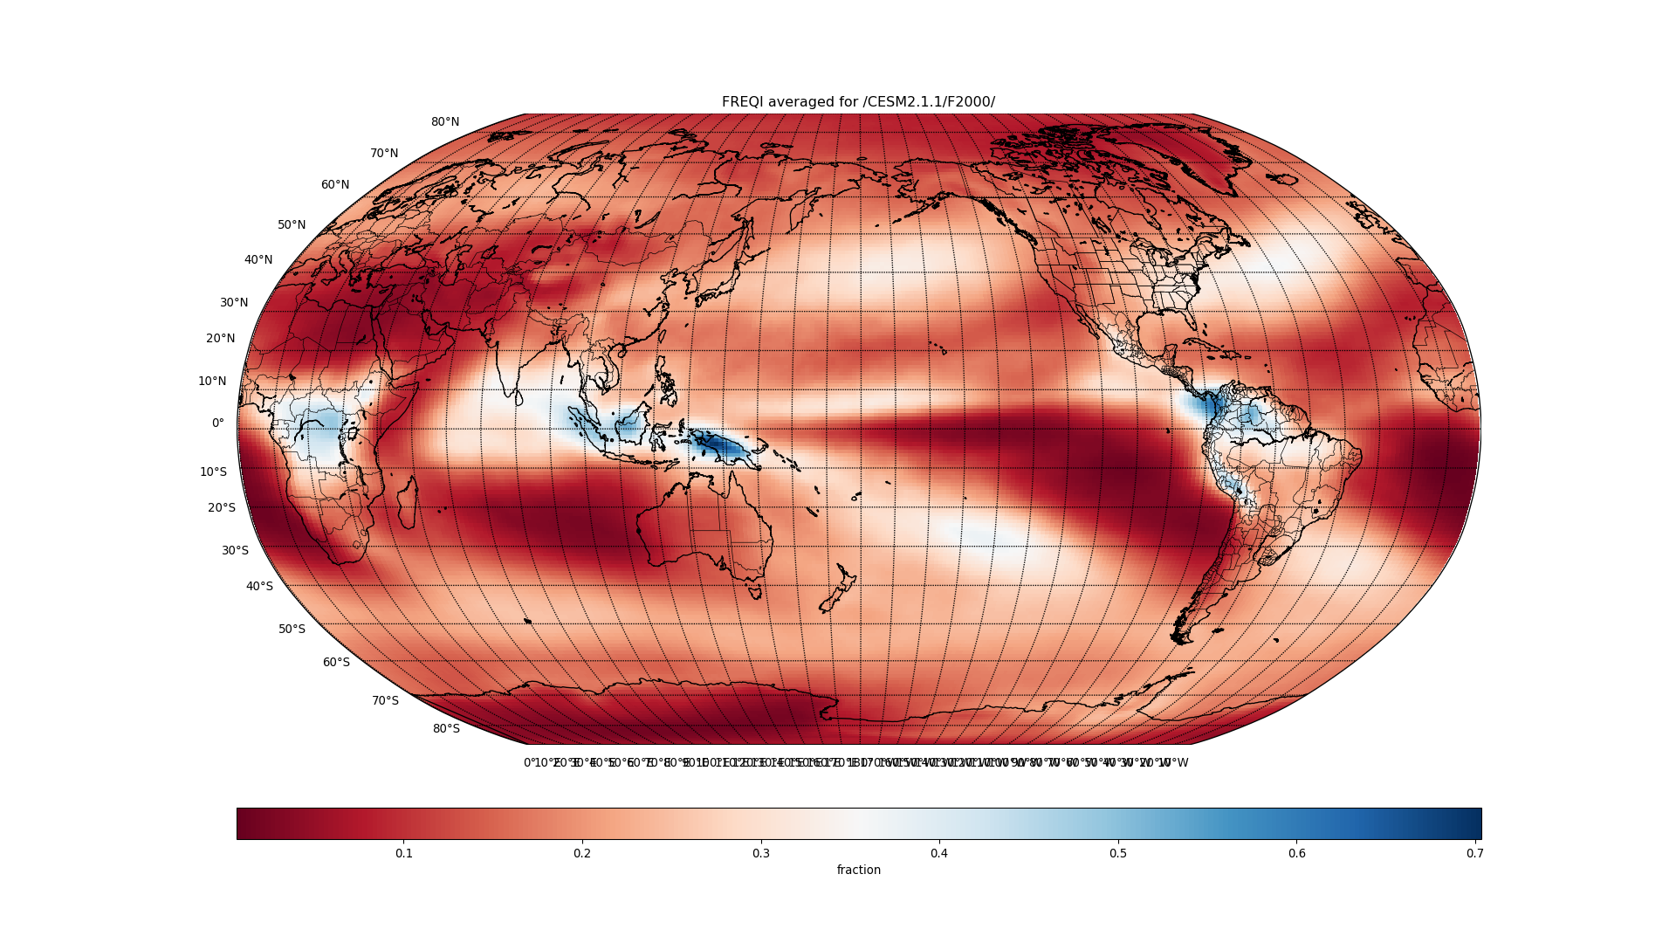

Slide 12
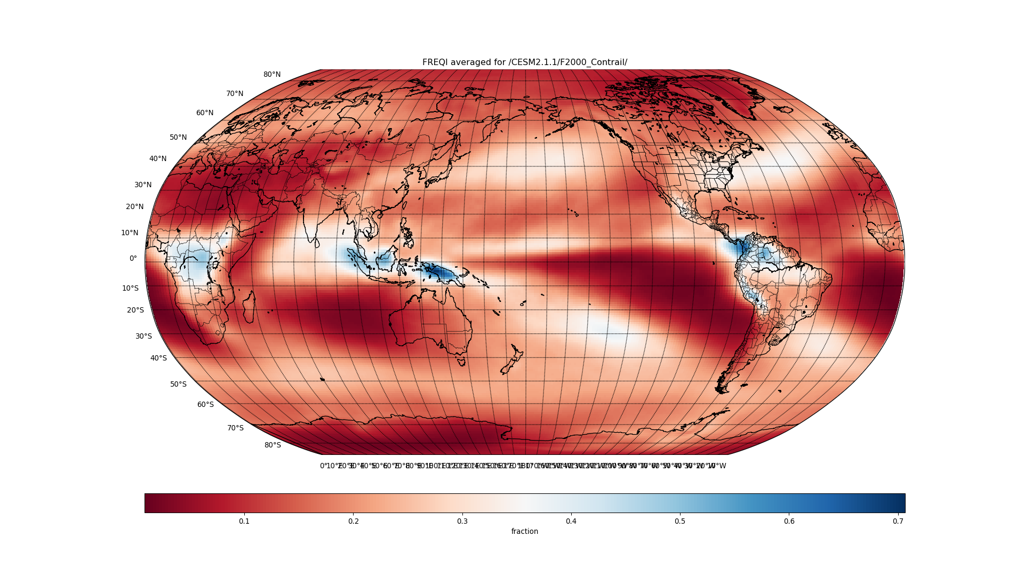

Slide 13
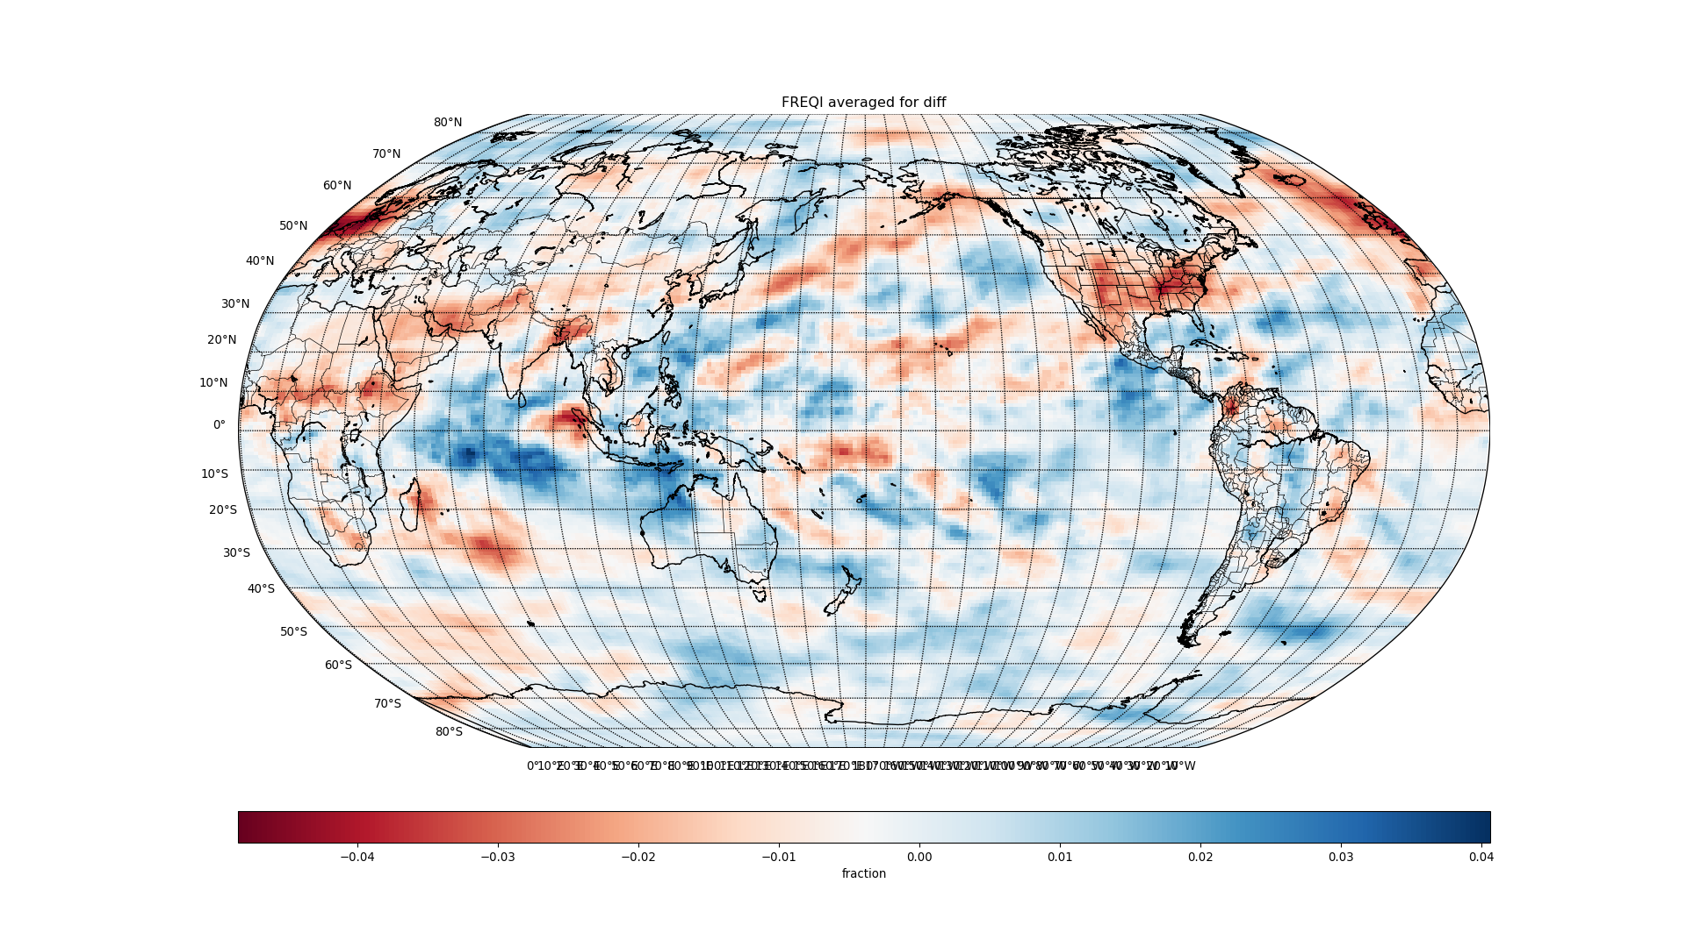

Slide 14
ICIMR

Slide 15
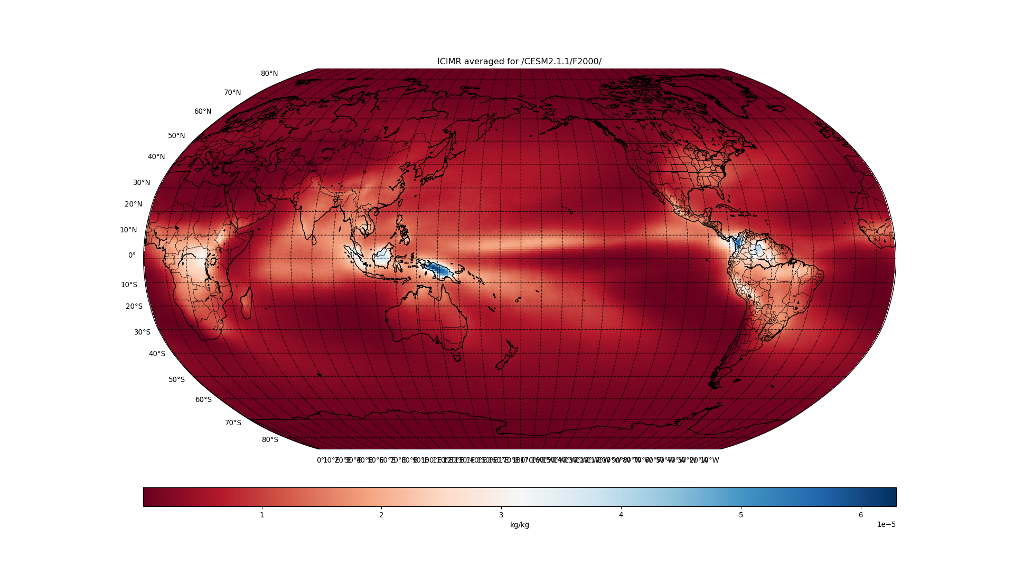

Slide 16


Slide 17
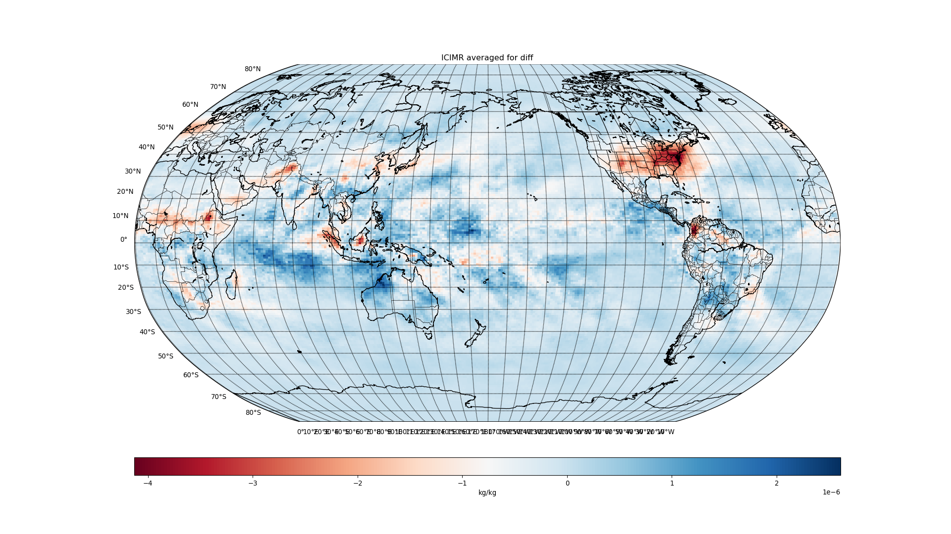

Slide 18
IWC

Slide 19


Slide 20


Slide 21
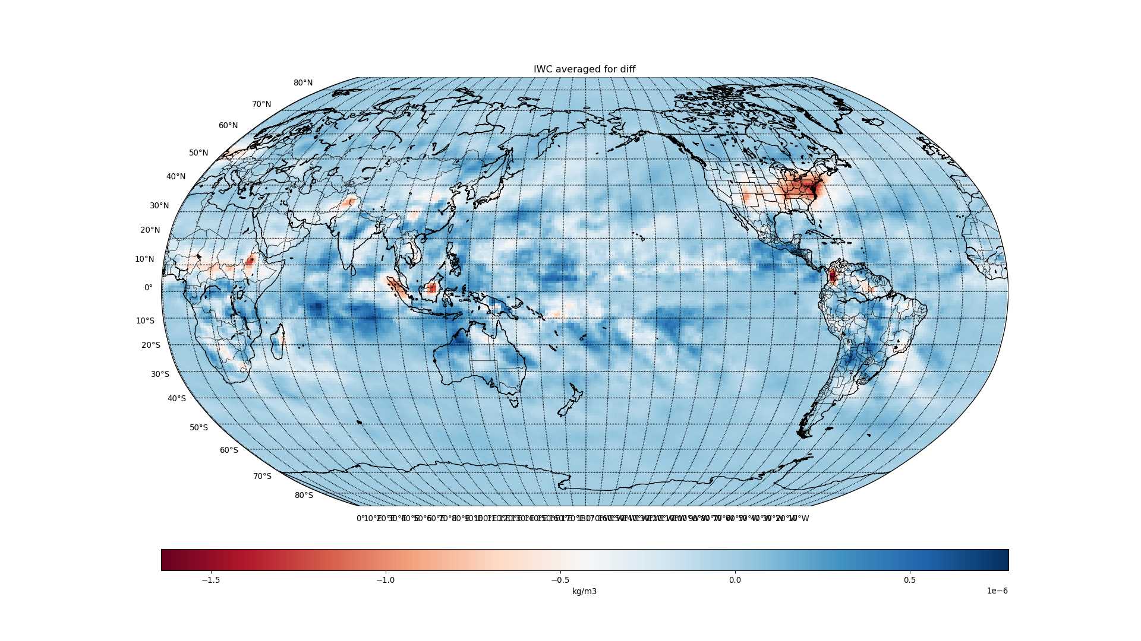

Slide 22
QRL

Slide 23
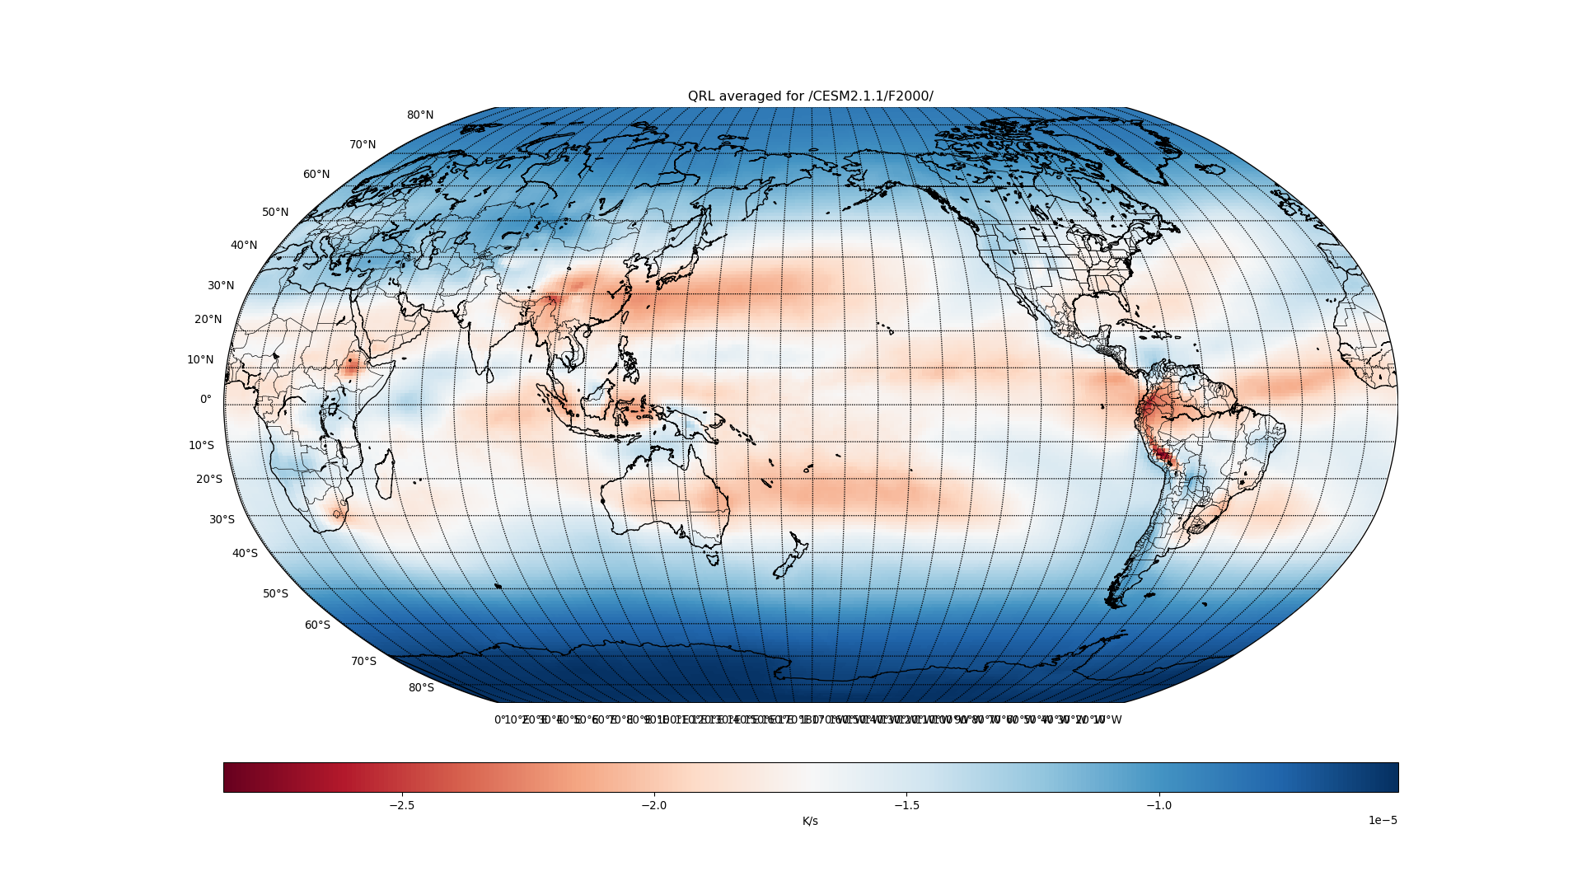

Slide 24
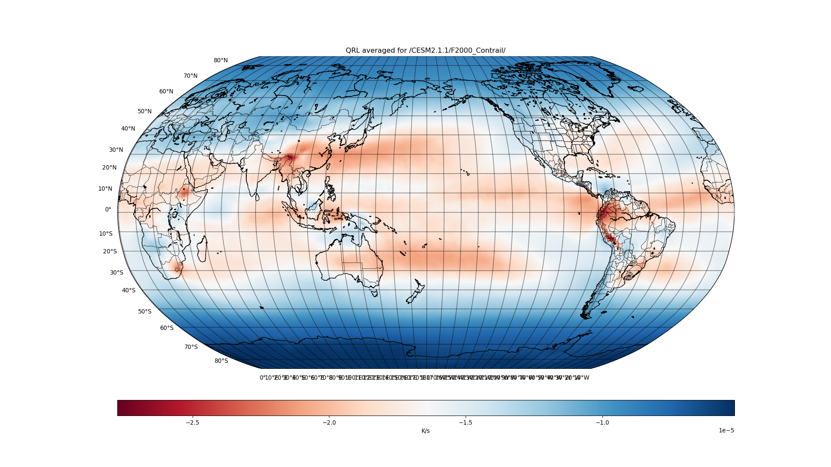

Slide 25
